Slide 1

Business Layer Patterns
Software Architecture
3rd Year – Semester 1
Lecture 4

Slide 2
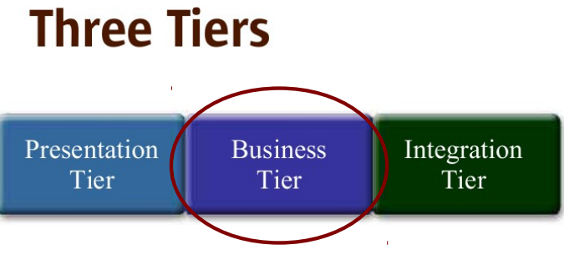
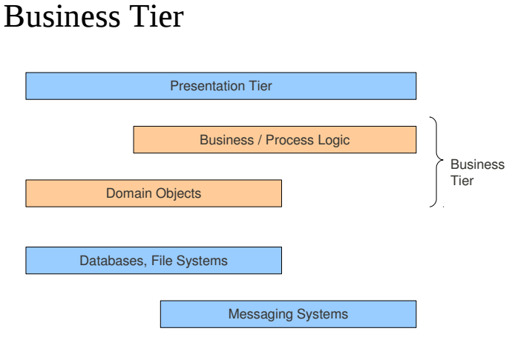

Slide 3
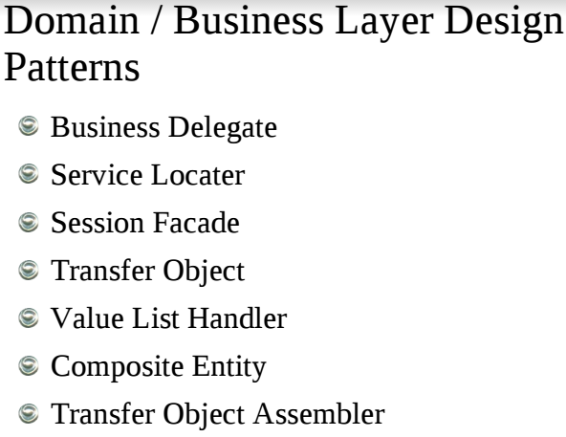

Slide 4
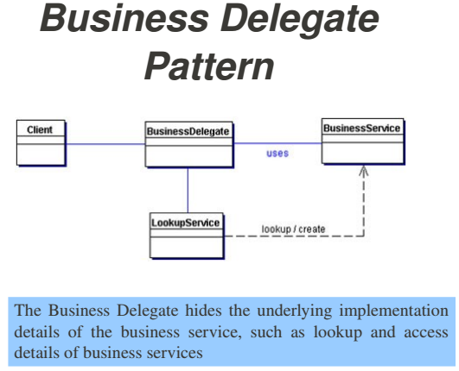
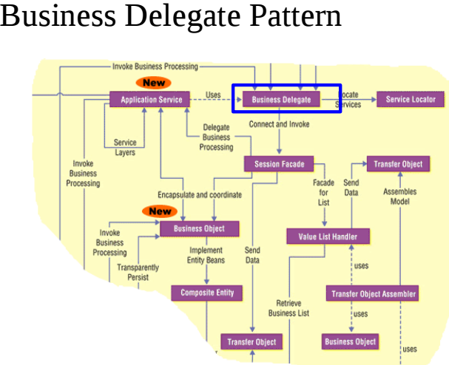
Notes:
Business Delegate Vs. Service Locator
Business Delegate will help to hide/shelter the actual implementation so the invoker (Presentation Tire) doesn’t have to know the internals. i.e. Less Coupling between Presentation Layer to the Business Service

Slide 5
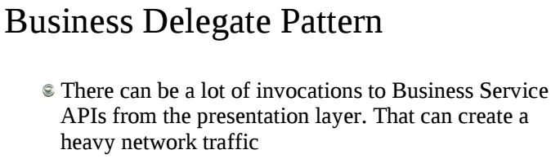
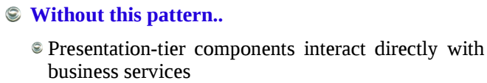
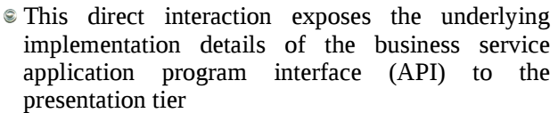
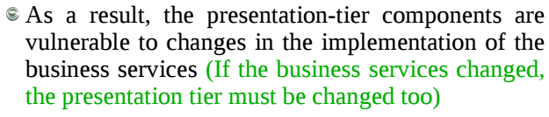

Slide 6
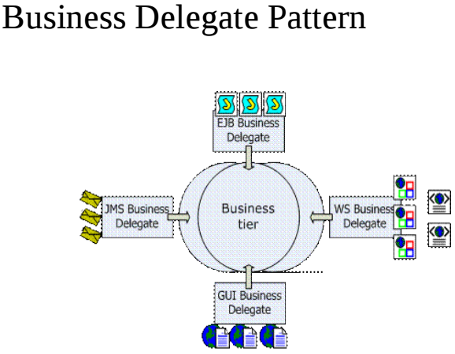
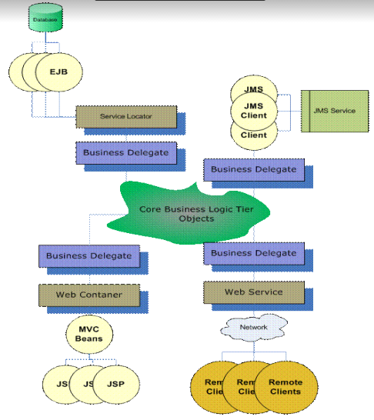

Slide 7
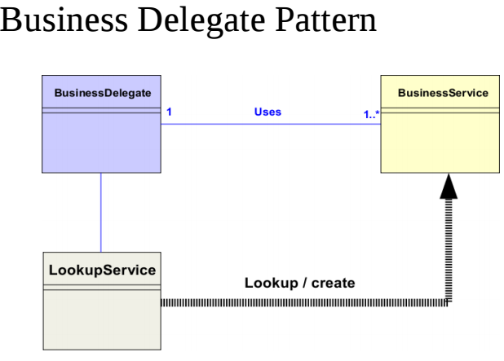
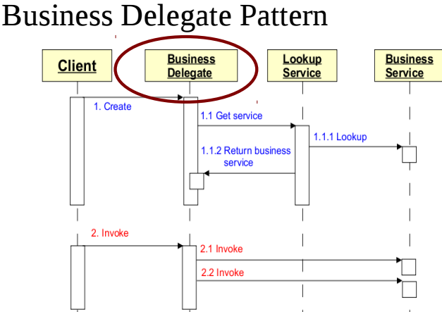
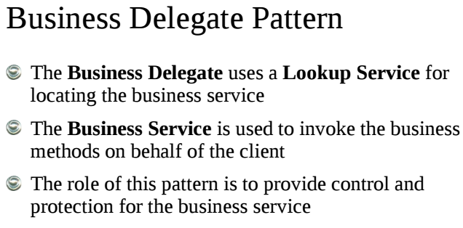

Slide 8
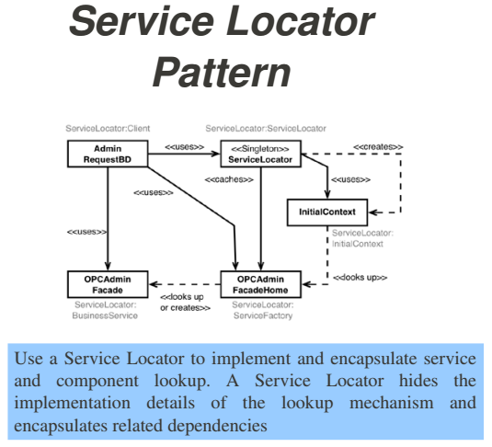
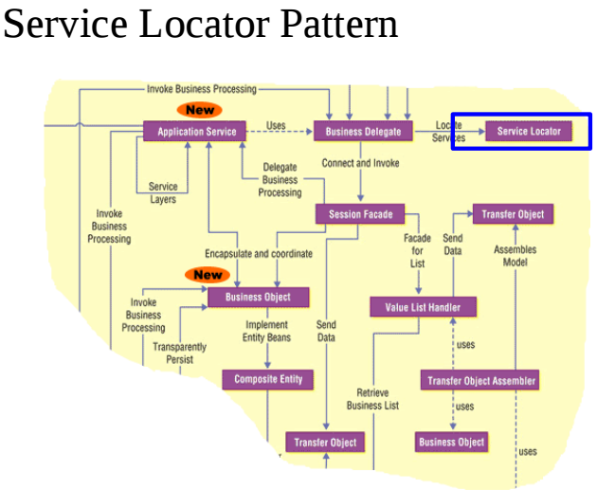
Notes:
Works well in the Distributed Systems Context

Slide 9
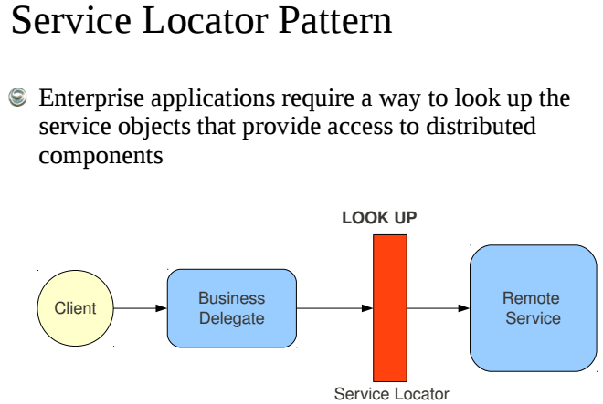
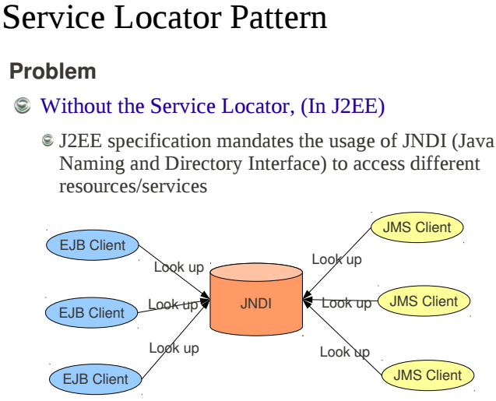
Notes:
Apache Software Download Mirror Sites

Slide 10
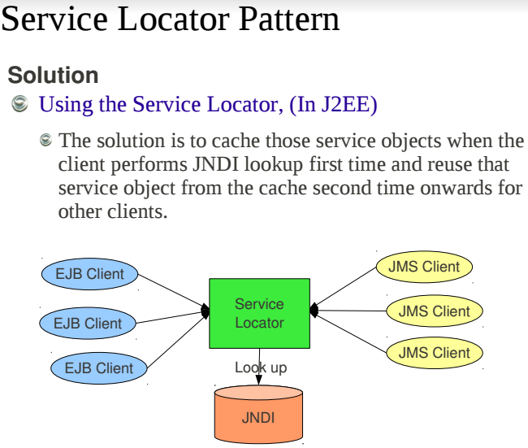
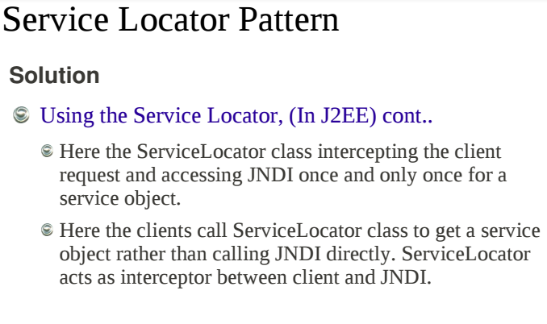

Slide 11
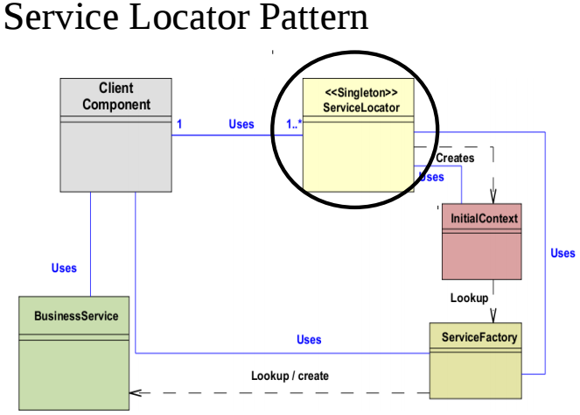
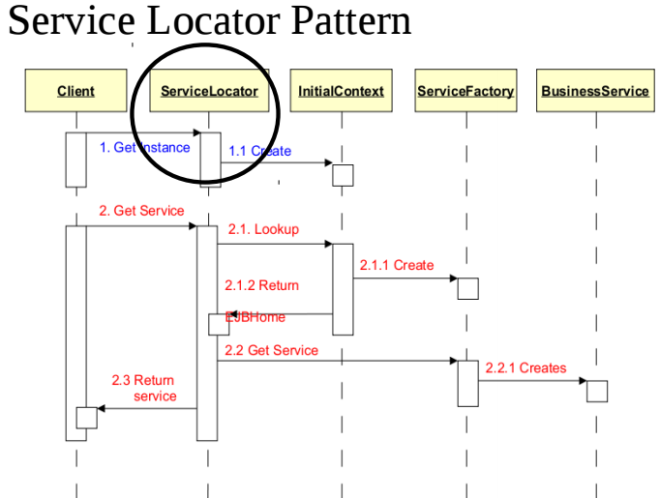

Slide 12
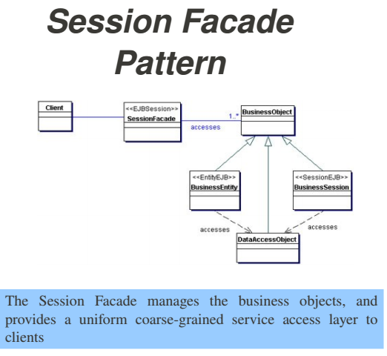
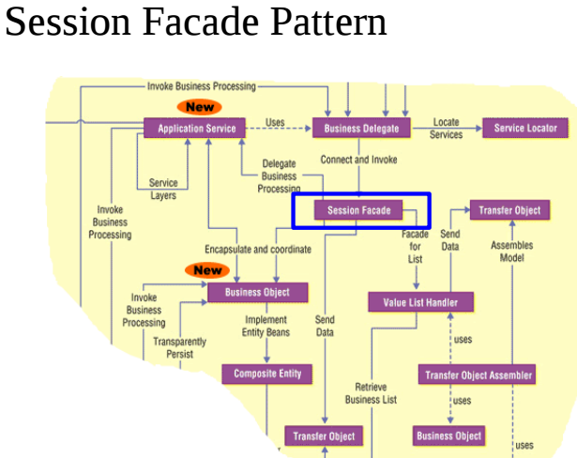
Notes:
Firewall HTTP Server vs. Actual Server Instances (e.g. Google.com)

Slide 13
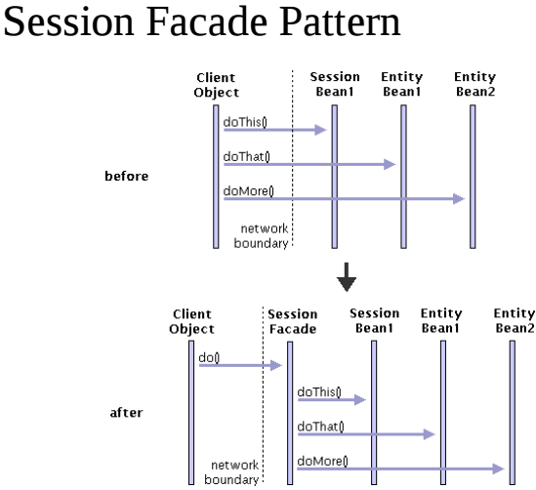
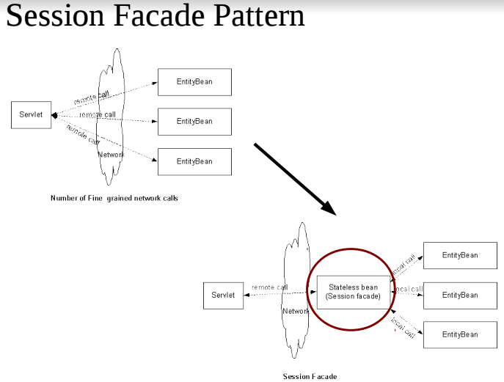

Slide 14
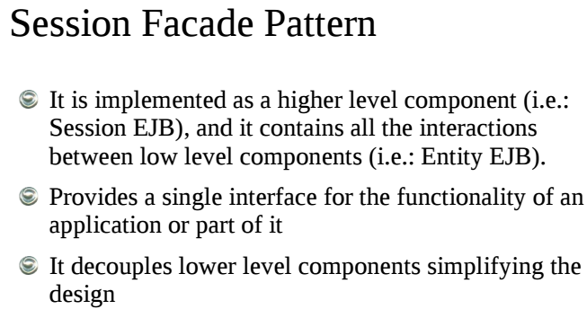
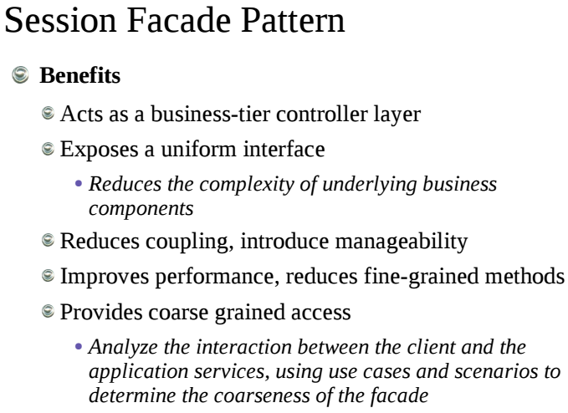

Slide 15
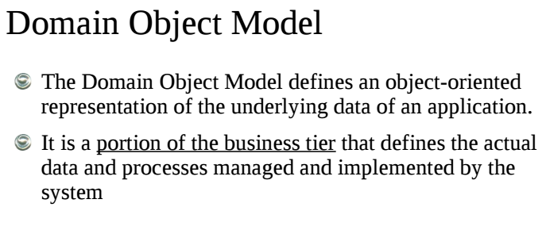
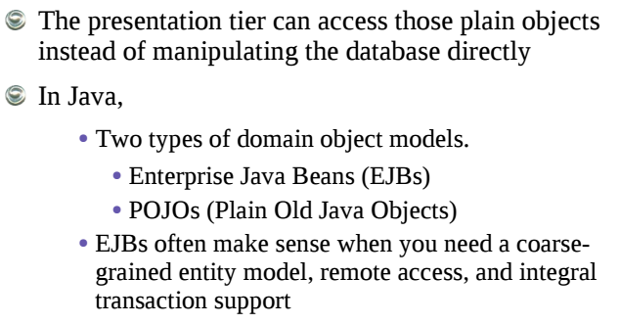
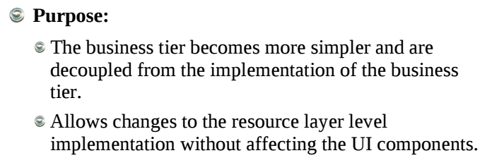

Slide 16
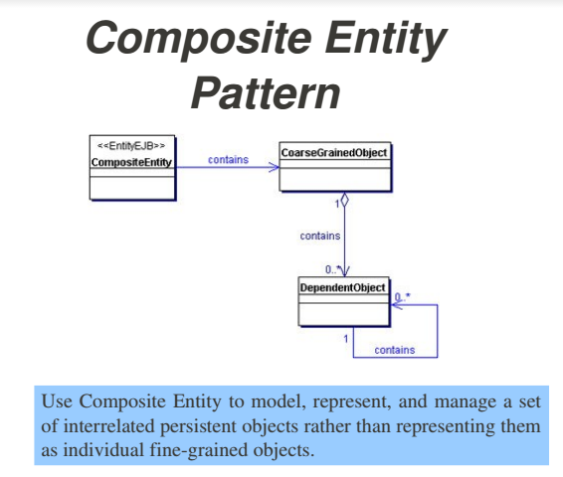
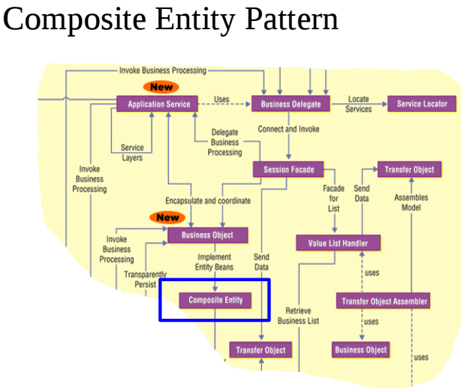
Notes:
Difference between Composition Vs. Aggregation
Composition is a Strong form of Aggregation where the part cannot exist without the whole
E.g.
University <1..M> Course | Course cannot exists without the University
Hall <1..M> People | People can exist without the Hall

Slide 17
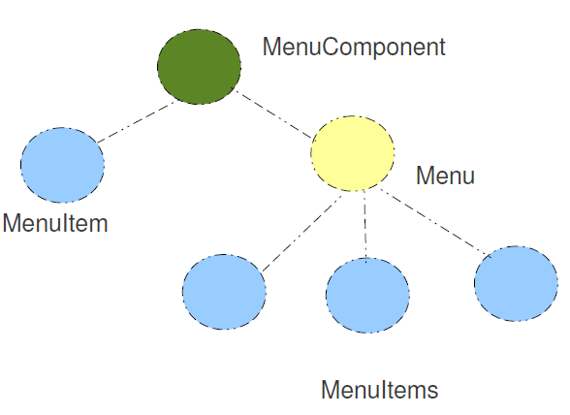
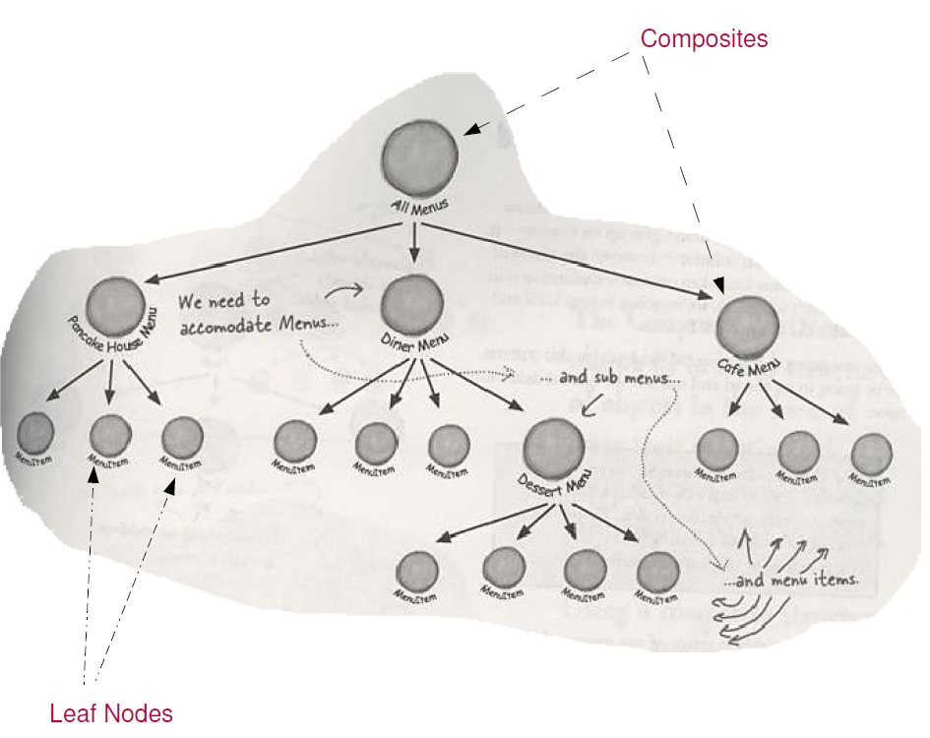

Slide 18
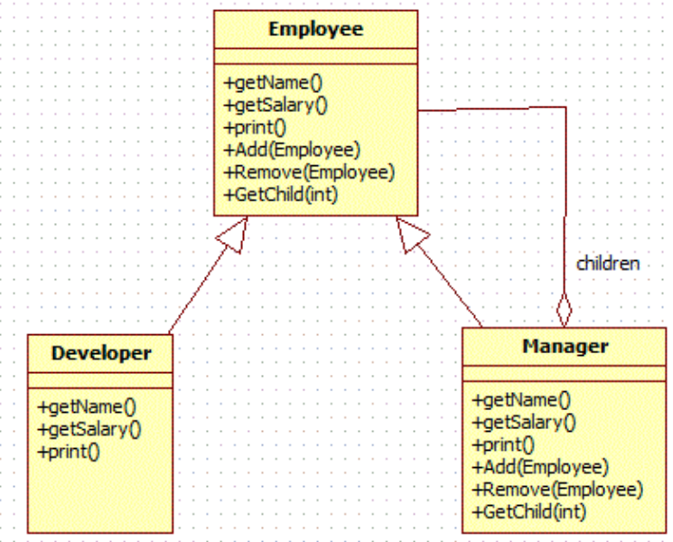
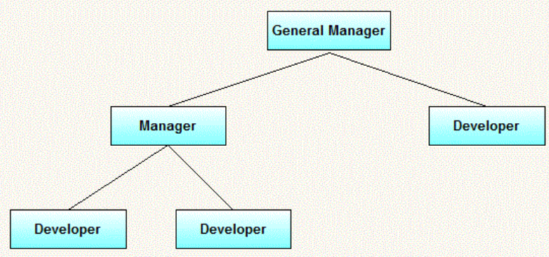
Exercise for Composite Entity Patterns

Slide 19
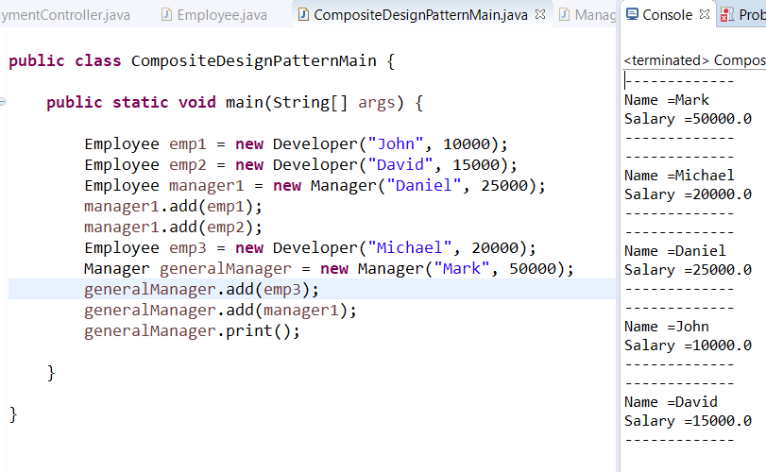
Test class for the Output

Slide 20
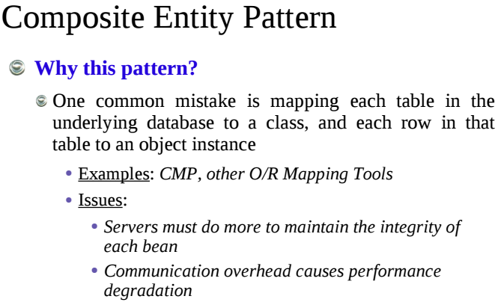
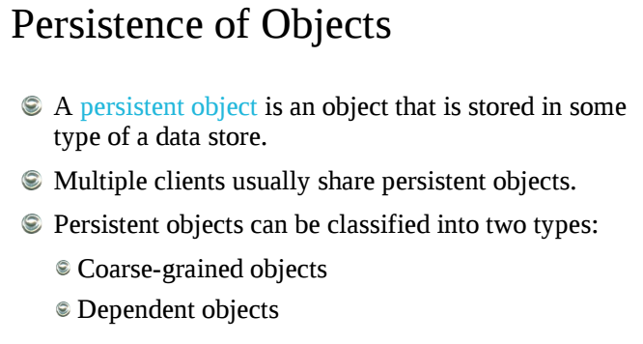
Notes:
OR Mapping 1:1, 1:M, M:1, M:M
Exercise:
Problem: A University has Students, those Students can take any Subjects. On the other hand a Subject can be offered to any Student. Marks will be recorded to each students per subject.
Question(s):
1) Identify the Entities, Draw ER Diagram
2) What kind of a relationships are there
3) Table Structure
Define a Service Interface to add marks to a particular Student for a particular Subject
Method 1: function setMarks(int studentId, double marks)
Method 2: function setStudentSubject(StudentSubject studentSubjectObj)
Method 3: function saveStudent(Student student)

Slide 21
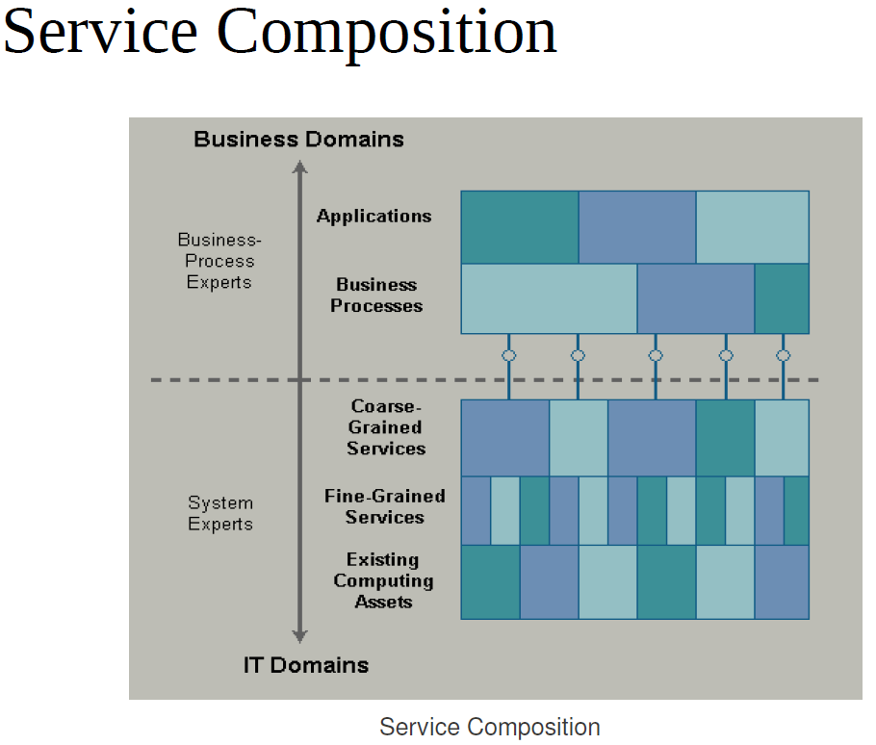
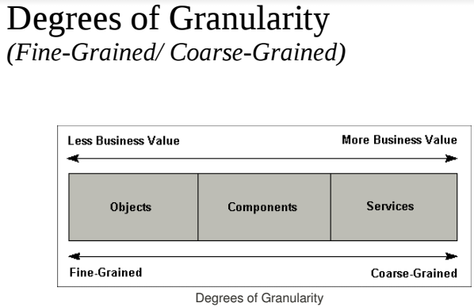
Notes:
OR Mapping 1:1, 1:M, M:1, M:M
Exercise:
Problem: A University has Students, those Students can take any Subjects. On the other hand a Subject can be offered to any Student. Marks will be recorded to each students per subject.
Question(s):
1) Identify the Entities, Draw ER Diagram
2) What kind of a relationships are there
3) Table Structure
Define a Service Interface to add marks to a particular Student for a particular Subject
Method 1: function setMarks(int studentId, double marks)
Method 2: function setStudentSubject(StudentSubject studentSubjectObj)
Method 3: function saveStudent(Student student)

Slide 22
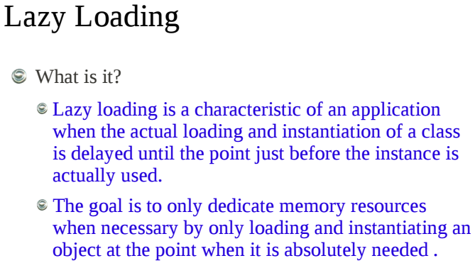
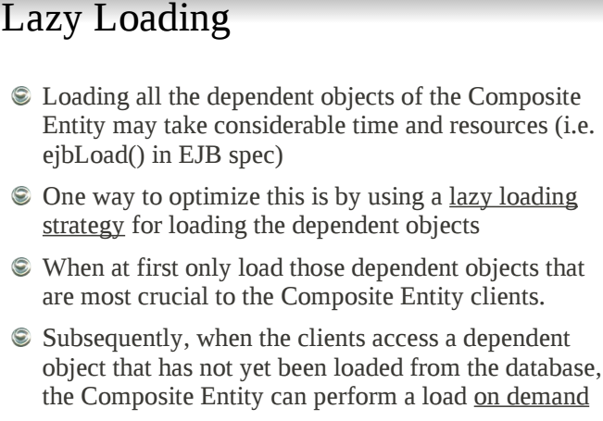

Slide 23
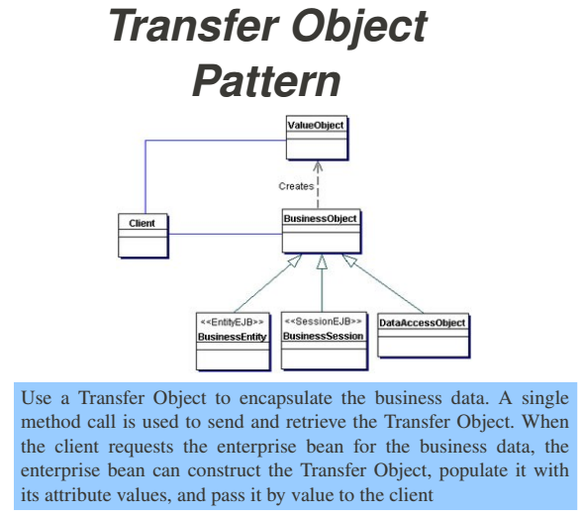
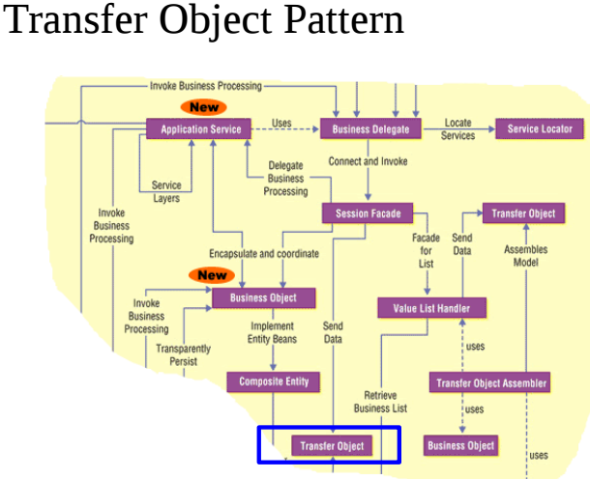
Notes:
Reduces Network Traffic
Enabled Transactions

Slide 24
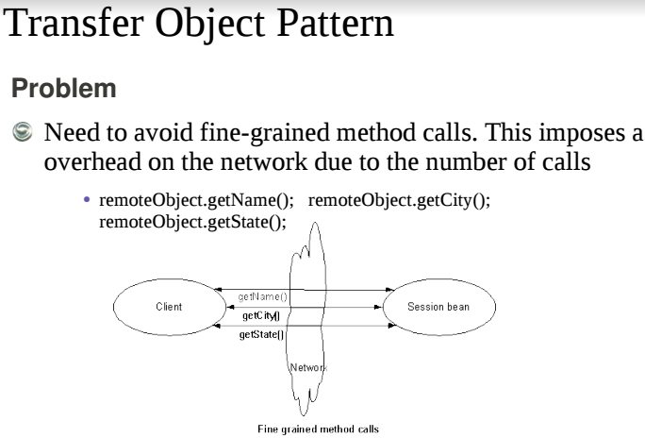
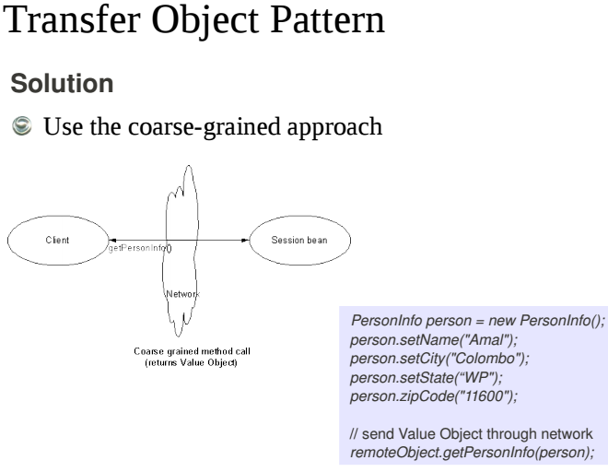

Slide 25
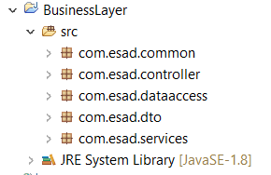
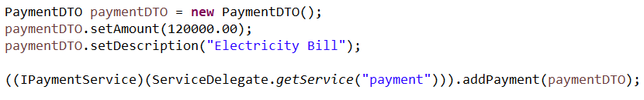
In-class Activity: Exercise for Business Layer Patterns Implementation
Implement the Business Layer assuming the request comes from Presentation Layer (Controller class) and invoke the business delegator (ServiceDelegator) class that fetches required business Services (PaymentService, ReservationService). You can implement common Service Interface that uses in all business services. Then the required request should be forwarded to the DataAccess Layer to execute necessary SQL query. You can apply Transfer Object Pattern to send the request among layers and in DataAccess Layer you can get those values to map to the Database Entities. Create suitable package hierarchy and Controller implementation should be as following piece of code.
Package Hierarchy
Controller Implementation

Slide 26


Notes:
How the DTO construct the data

Slide 27

Exercise - Builder
Create a class Hierarchy to as shown and based on the builder in VehicleAssembler class implement to assemble the object.
During the Assemble you should assemble Tyres, engine, chassy, and outer framework and return the relevant vehicle object

Slide 28

Exercise Output

Slide 29


Slide 30



Slide 31


